Slide 1
What Is the Purpose of a College Education Today?
202511290 정지원

Slide 2

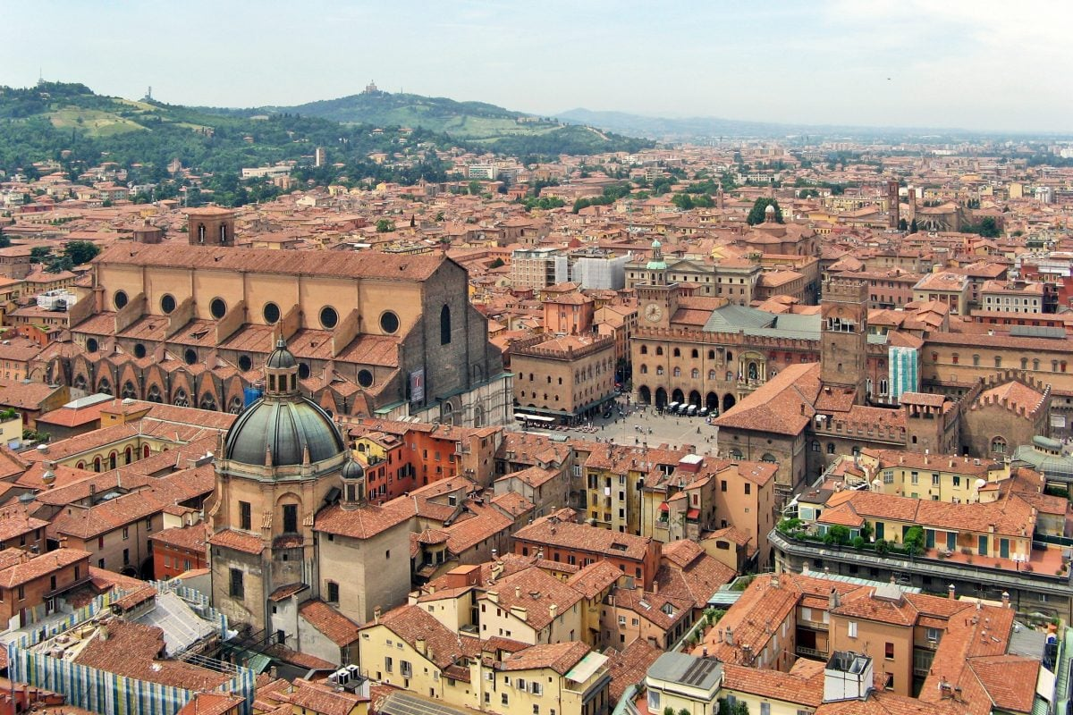
University of Bologna

Slide 3





Slide 4



Slide 5


Slide 6


Slide 7


Slide 8


Slide 9


Slide 10


Slide 11


